Slide 1
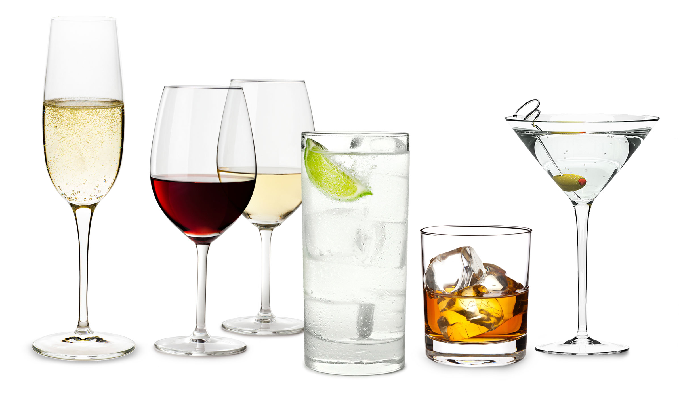
Alcohol Sales Prediction
Presented by
Monika Munjal

Slide 2
INTRODUCTION
There has always been a need by the business owners to know the demand for their products. This benefits the whole business model as it stockpiles the revenue. This model deals with the prediction of the consumption of different alcoholic beverages.
Dataset: We have used the dataset provided by IOWA Department of Commerce, Alcoholic Beverages Division. The dataset size is 549MB with 2.38M million rows and 24 columns.
Objective: The main aim is to compare the different Machine Learning Models to check the Root Mean Squared Error, Mean Absolute Error and R² Error on the dataset of alcohol sales prediction. We will see how Ridge Regression, Random Forest and XGBoost Models perform on our IOWA alcohol sales dataset.

Slide 3
METHODOLOGY
1. Data Selection There are lots of different datasets available for alcohol sales prediction. In this Project, used the dataset which is provided by Iowa Department of Commerce, Alcoholic Beverages Division. Please find the link below:
https://data.iowa.gov/Sales-Distribution/2019-Iowa-Liquor-Sales/38x4-vs5h
2. Data Preprocessing Once the dataset is extracted, there were several issues with the data before it can go for further analysis. Data cleaning and transformation according to the proposal needs to be configured. All the rows with null values should be deleted from the data, dropping duplicate rows. Feature extraction should be kept in mind in this stage. Although the size of the liquor data is huge, but by data preprocessing standards it should be cleaned appropriately so that we can analyze the data accordingly.
3. Data Transformation or Data Reduction It is necessary to convert the categorical variable into numbers as ML models only takes the numbers as a input. So in our dataset the columns like Store Name, Category Name, Vendor Name had categorical values.

Slide 4
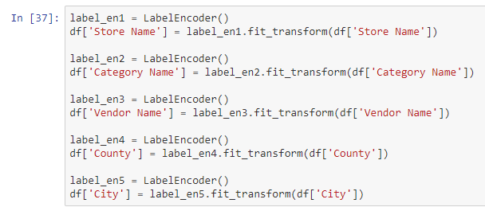

Encoding categorical variables It is necessary to convert the categorical variable into numbers as ML models only takes the numbers as a input. So in our dataset the columns like Store Name, Category Name, Vendor Name are categorical.
Separate the target feature from the dataset

Slide 5
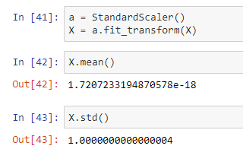
Data Standardization
In Data Standardization-performed zero mean centring and unit scaling; i.e. To make the mean of all the features as zero and the standard deviation as 1. Thus used mean and standard deviation of each feature.
4. Data Visualization and Exploration
Data visualization is an important part of the any machine learning model that we build. The visualization gives us more ideas about the distribution of data and insights of data. The visualization can be any type of graphs, charts, and so on. In Python, there are various libraries available for the visualization of the data.

Slide 6
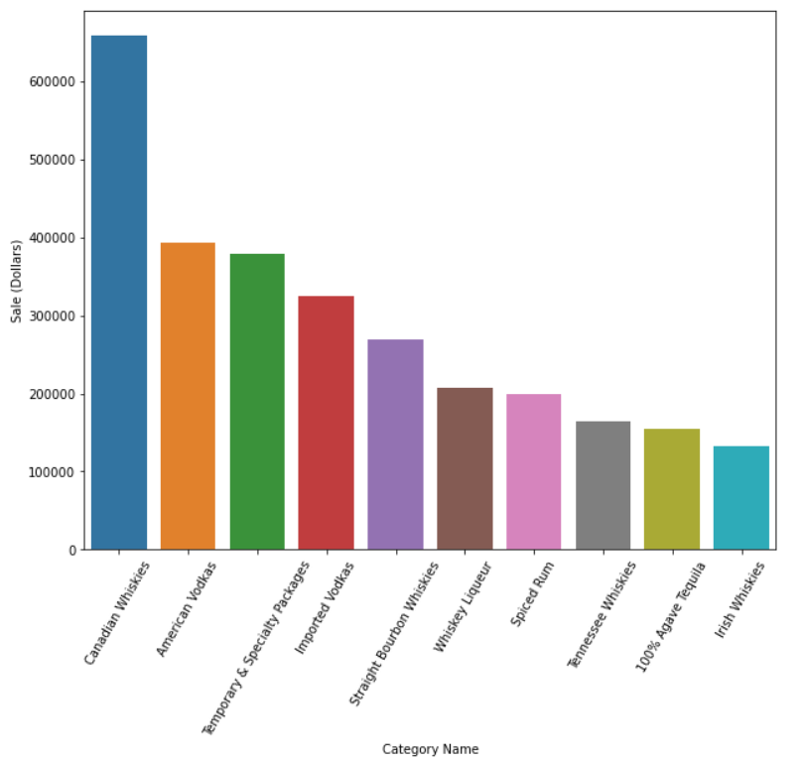
Top 10 categories of liquors that has highest sale Created a bar graph to see which liquor has highest number of sales
Insight: As we can see that the canadian whiskies has high number of sales may be becuase peoples like to drink it more or it can be very famous liquor brand as well.

Slide 7
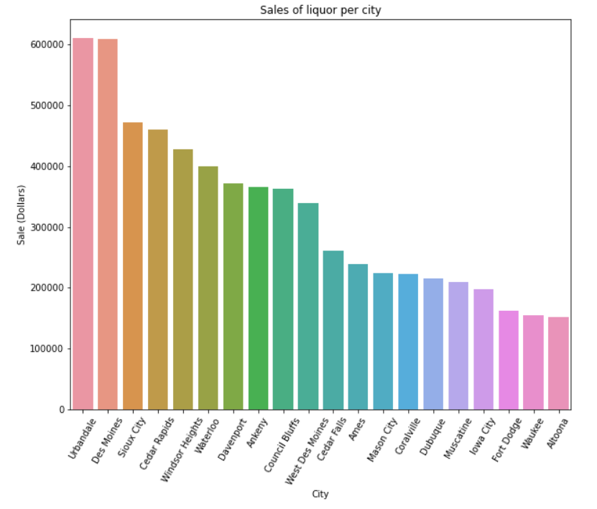
Top 10 cities for sales of liquors The below bar graph to see which city has highest number of sales.
Insight: The Urbandale city has highest sales of liquors.

Slide 8
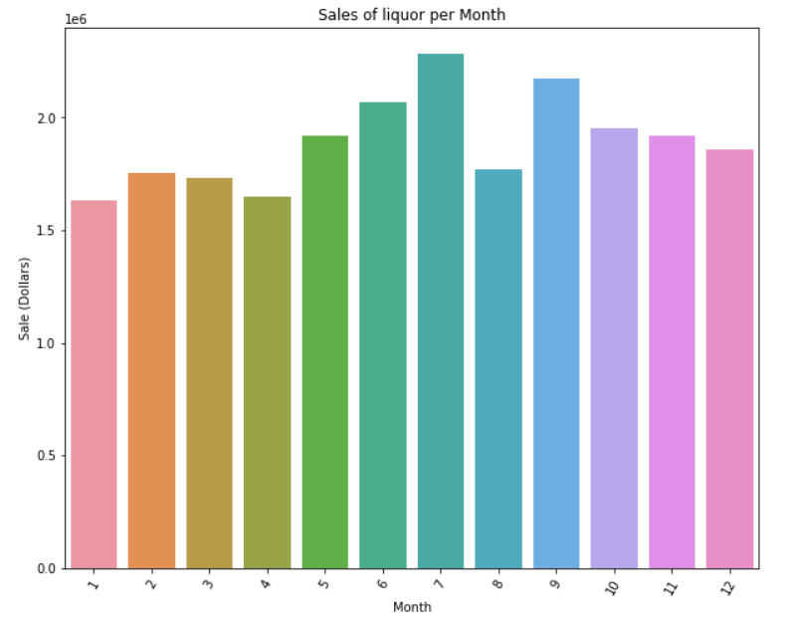
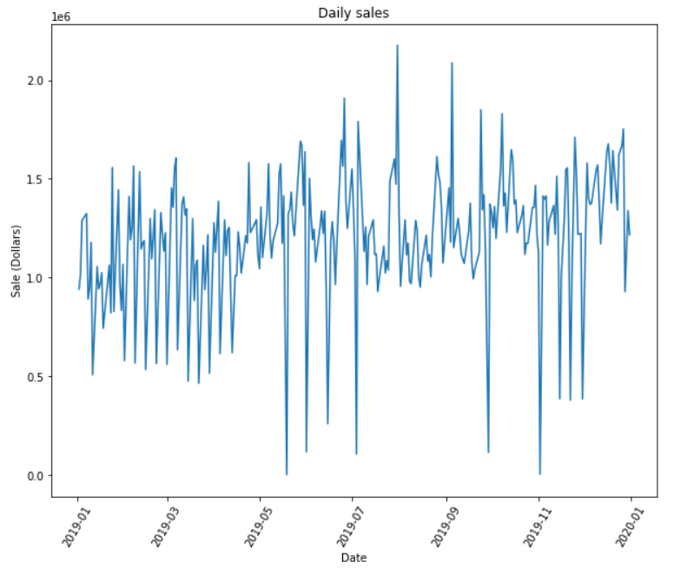
Sales of liquors per month Created a bar graph shows the amount of liquor sold for the months respectively.
Insight: From the above plot it is cleared that the July month has highest number of sales of liquors.

Slide 9
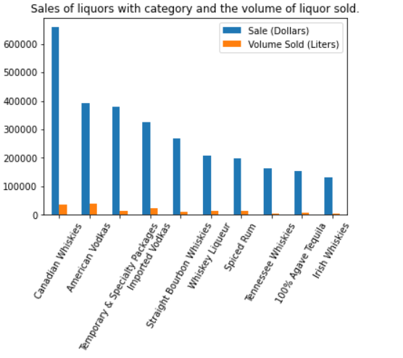
Sales of liquors with category and the volume of liquid sold.
Insight: Canadian Whiskies has highest sale with the 36K litre.

Slide 10
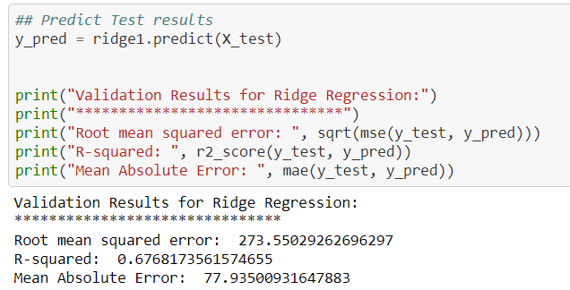
5. Machine Learning Models used:
As we are dealing with predicting the sales of alcohol which is a continuous variable that can have any value. So it is a regression problem if we talk in terms of ML terms. The following ML algorithms are applied to the dataset after preprocessing and cleaning:
1. Ridge Regression

Slide 11
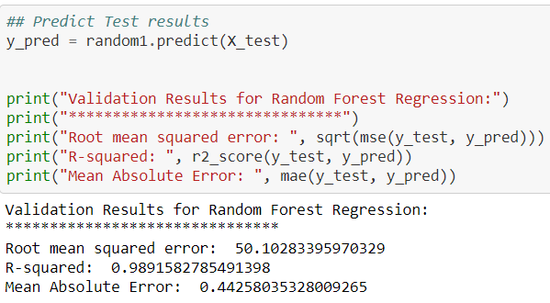
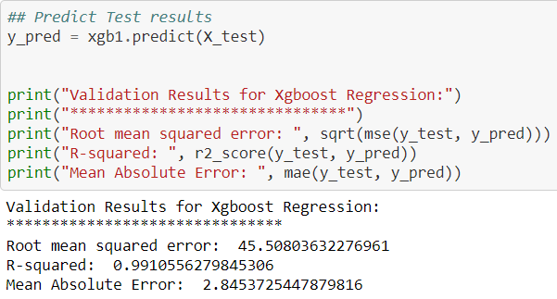
2. Random Forest Regression
3. XGBoost

Slide 12
Results and Discussion
6. Performance Evaluation:
Root Mean Squared Error
Mean Absolute Error
R² Error
Model | Root Mean Squared Error | R Squared | Mean Absolute Error
Ridge | 273.55 | 0.67 | 77.93
Random Forest | 50.10 | 0.98 | 0.44
XGBoost | 45.50 | 0.99 | 2.84

Slide 13
Conclusion and Future Work
This Project demonstrates alcohol sales prediction with the help of different Machine Learning algorithms. We have seen the XGBoost Model gives the most accurate prediction. Along with the model’s performance, RMSE and MSE values help us believe in the model by showing the accuracy. Since I have worked on the alcohol sales prediction on the IOWA dataset, the future work can include some of the following points in order to improve the performance of the model.
1. Dataset having alcohol sales of different regions.
2. Trying different Algorithms.

Slide 14
Thank You

